Slide 1
Machine Learning Models to predict AD disease
Team: Brick Carrier
Xinyu Wang(xw474)
Chengjie Lin(cl2445)
Deepak Agarwal(da475)

Slide 2
The Problem
TADPOLE: The Alzheimer's Disease Prediction Of Longitudinal Evolution
Prediction of clinically relevant variables
MMSE
ADAS13
Head-size normalized ventrical volume
Final prediction to classify the patient as
Healthy
MCI (mild cognitive impairment)
AD diagnosed

Slide 3
Dataset
Dataset collected from ADNI available at adni.loni.usc.edu
Dataset divided into: training, testing and validation
Around 450 different patients in training dataset, __ in test and __ in validation
Each patient has multiple visits and each visit has data corresponding to around 2000 columns

Slide 4
Data description
Like a typical clinical scenario, the input data is not uniformly filled i.e. the data is not present for all visits. Also, for each subject, there are multiple visits at different timestamps and intervals of the those visits is not regular. Moreover, the number of visits for each subject is also not same. In a nutshell, the patient data has many irregularities which brings out the need of good data preprocessing techniques.

Slide 5
General Input Preprocessing
Input data filtering
1. Remove less-meaningful data
NaN
NaN
data
NaN
NaN
NaN
NaN
Remove such columns where NaN is present more than 70% of the times

Slide 6
Input Preprocessing (Contd)
2. Remove same-value column for eg. TEMPQC_UCSFFSL_’ had PASS present 99% of times and across different diagnosed categories
PASS
FAIL
PASS
PASS
PASS
PASS
PASS
Remove such columns where same data is present for different diagnosis categories, making it unworthy

Slide 7
Input Preprocessing (Contd)
3. Performed PCA as the final step after step 1 and step 2
Final columns reduced from 1892 to 338

Slide 8
Output Processing
1. Deleted subject data having NaN for all visits
2. Deleted subject data which atleast one column being NaN for all visits

Slide 9
Input and output imputation
1. Replace all the blanks in the csv file to NaN
2. Order the input samples by its PTID_KEY so that it will be easier for us to impute since the missing value will be estimated using linear interpolation

Slide 10
Base Algorithm
TODO: visual diagram
Based on LOCF: Last Output Carry Forward
Accuracy achieved:
Doesn’t make use of historical data
Simple to implement but can be highly inaccurate

Slide 11
Alternative Models
Based on literature review, we came up with these alternative models for the three continuous variable predictions
Supervised Learning
SVM: Support Vector Machines
Deep learning
Data-modified LSTM
T-LSTM

Slide 12
Performance Analysis
Metrics used
mAUC (area under ROC curve) for classification problem
MAE for regression problems

Slide 13
SVM
General Strategy
We will use the Support Vector Regression (SVR) to predict the 3 continuous variables and use Support Vector Classification(SVC) and predicted continuous variables from previous SVR to predict the one categorical variables.

Slide 14
SVM (Contd)
To transform this time series prediction into a regular supervised learning., we ordered the input samples and output with patient id (PTID_KEY) as before, then we took cross-product of these two csv based on the same PTID_KEY.
Cross-product graph goes here

Slide 15
SVM (Contd)
2. For each of the input sample, we added a feature T(time interval of the input and the output), which is the Date in output minus ExamDate in input with unit of month.
Example:

Slide 16
SVM (Contd)
3.Once we get 3 continuous variables (ADAS13, Ventricles_Norm, MMSE) from Support Vector Regression from above section, we can use these 3 variables as 3 features, along with other 7 selected feature, to generate new input data to predict the categorical variable using Support Vector Classification.

Slide 17
Why LSTM: Time-series data
1. The time-series nature of the data.
2. Leads to the use of LSTM

Slide 18
LSTM idea
For a many-to-one LSTM model, the input is shaped into the [samples, timesteps, features] in the Keras context. The idea is that every patient correspond to a datapoint, the visits of the patient correspond to the timesteps in this datapoint. In this way, we can feed the medical records into LSTM network. However, our unorganized input data and output data have many problems that make it difficult to fit into traditional LSTM model. Unroll the LSTM and the problems are explained as below.

Slide 19
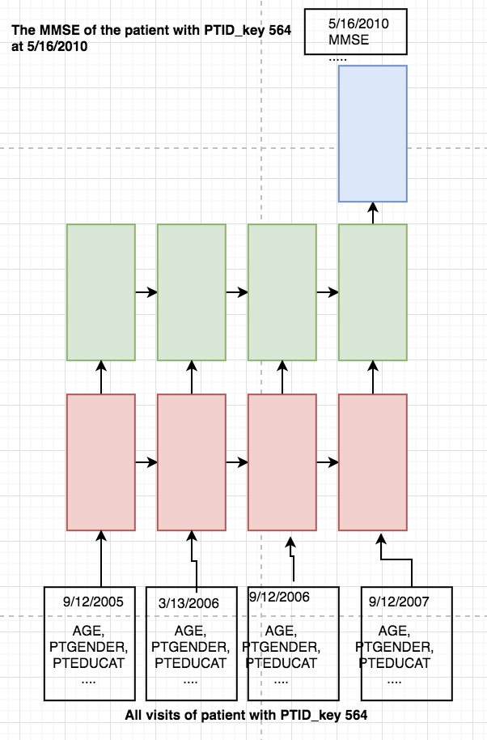
LSTM network unrolled
What we want: Each patient stands for a datapoint. The total visits of a patients are the total timesteps of this datapoint. As shown on the left, for patient with PTID_key 564, there are 4 visits, which means 4 timesteps in this datapoint

Slide 20
LSTM dilemma
The problems: P1. the time interval between two visit is different, which is against the uniform and regular sampling rate in the LSTM model. (time of irregularities problem) P2. For a many-to-one model, the output of it should be the output at the last timestep, which should be the output variables at 9/12/2007. However, the output data given is the output at the future time, which is the health status variables of the patient in 5/16/2010. P3. Different patients has different number of visits, which means that in the training process, the timesteps in each datapoint is different, which is unacceptable.(various timesteps in datapoints )

Slide 21
How to solve the dilemma
1. Hack the data - data-modified LSTM
2. Hack the architecture - architecture-modified LSTM

Slide 22
Data-modified LSTM
How we modify the data
1. To solve P3: Masking the input with maximum number of visit.
Screenshot
2. To solve P2 and P1: To eliminate the time factor in the data. We transformed the time difference between the input data and output result into a feature of input data.
Screenshot

Slide 23
Data-modified LSTM (Contd)
How we modify the data
3. Lastly, we noted that there are multiple outputs for each patients. For example, if there are 3 output for patient with PTID_KEY 564, which are output A at 5/16/2010, output B at 3/17/2011, output C at 8/2/2012., we can generate 3 training pairs. In each training pair, we have different output, and different input since the △t changes in the datapoint as the output date changes.
//Screenshot

Slide 24
Data-modified LSTM (Contd)
Specifics of implementation

Slide 25
The disadvantage of data--modified LSTM
It simply uses the time difference as new feature, which lacks solid explanation and proof of concept from the theory point of view.
Can we find some modified LSTM that relatively applied to the problems mentioned above from the architecture aspect.
1. Phased LSTM [1]
2. DeepCare [2]
3. Adaptive Computation Time [3]
4. Time-aware LSTM [4]

Slide 26
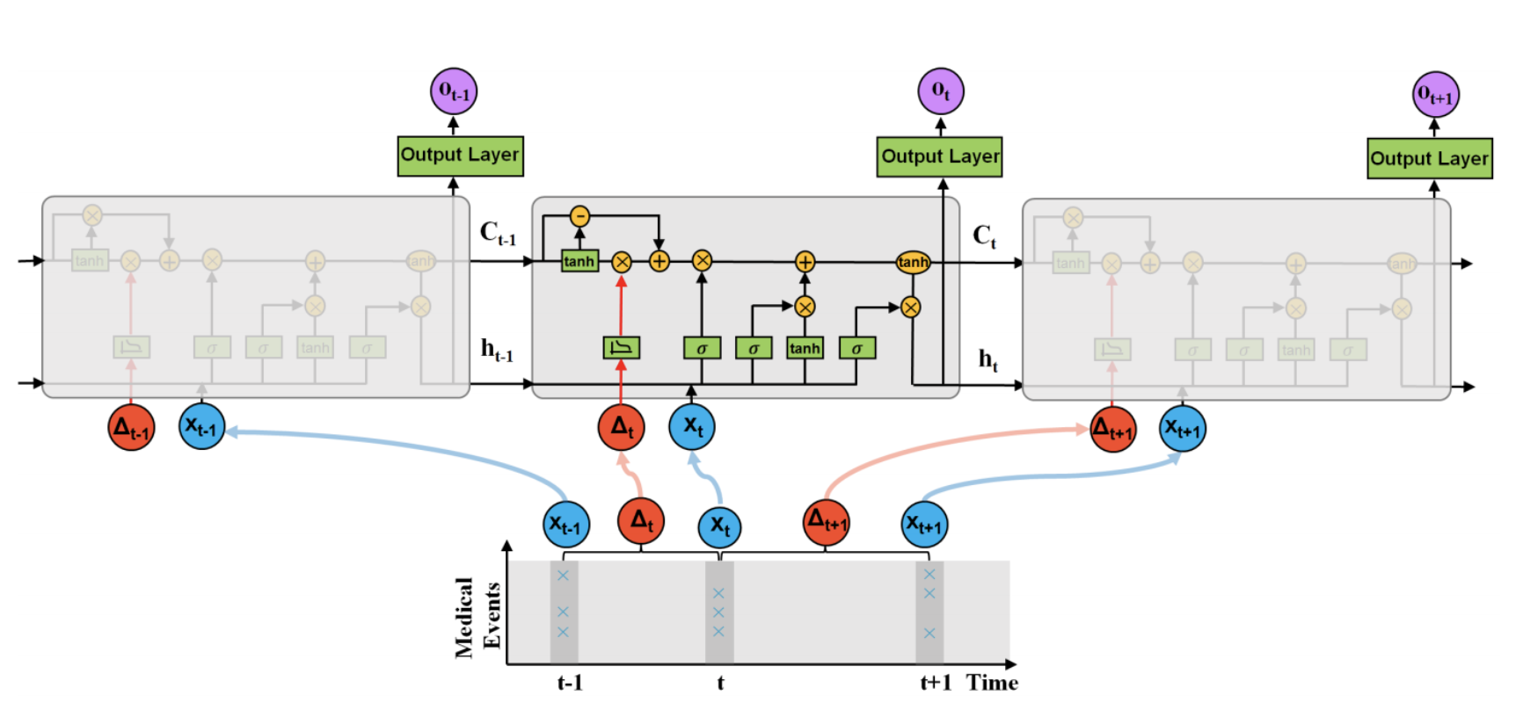
Time-aware LSTM
T-LSTM takes two inputs, input record and the elapsed time at the current time step. e time lapse between the records at time t −1, t and t +1 can vary from days to years in healthcare domain. T-LSTM decomposes the previous memory into long and short term components and utilizes the elapsed time (∆t ) to discount the short term effects. Thus we solve P1.

Slide 27
Time-aware LSTM (Contd)
To solve various timesteps problem (P3) and of the LSTM dilemma, instead of zero padding, same length sequences are put in the same batch. For example: L is the list containing all the batches with a length of N. L[0].shape gives [number of samples x sequence length x dimensionality]. [441*2*336] means there are 441 patients with 2 visits and 336 features.
//Screenshot from Matlab

Slide 28
Time-aware LSTM (Contd)
In this architecture-modified LSTM, (P3) is solved by inserting one extra timestep in the datapoint with the same date as the output result and all the features copied from last timestep. The way to handle the multiple output is same as the 3.4.2, where one output leads to one training pair.
//Carry-forward model graph goes here.

Slide 29
Time-aware LSTM (Contd)
Implementation details
Key Point: The original data needs to be transformed from CSV to the .mat format of MATLAB.
The original information is decomposed into three .mat file. (i) Result_patient.mat: 1*12 cell, each cell yields[ number of patient * visit times+1* features] (ii)Result_types.mat 1*12 cell, if classification task, each cell yields[ number of patient * one-hot encoded output]. If regression task, each cell yields [ number of patient *1 ](iii)Result_time.mat: 1*12 cell, each cell yields[ number of patient * 1*time elapse of visits].

Slide 30
Results of all the models

Slide 31
Benchmark
Graphes goes here

Slide 32
Analysis

Slide 33
Conclusion

Slide 34
Reference

Slide 35
Any Questions?
Thank You !!!

